Slide 1
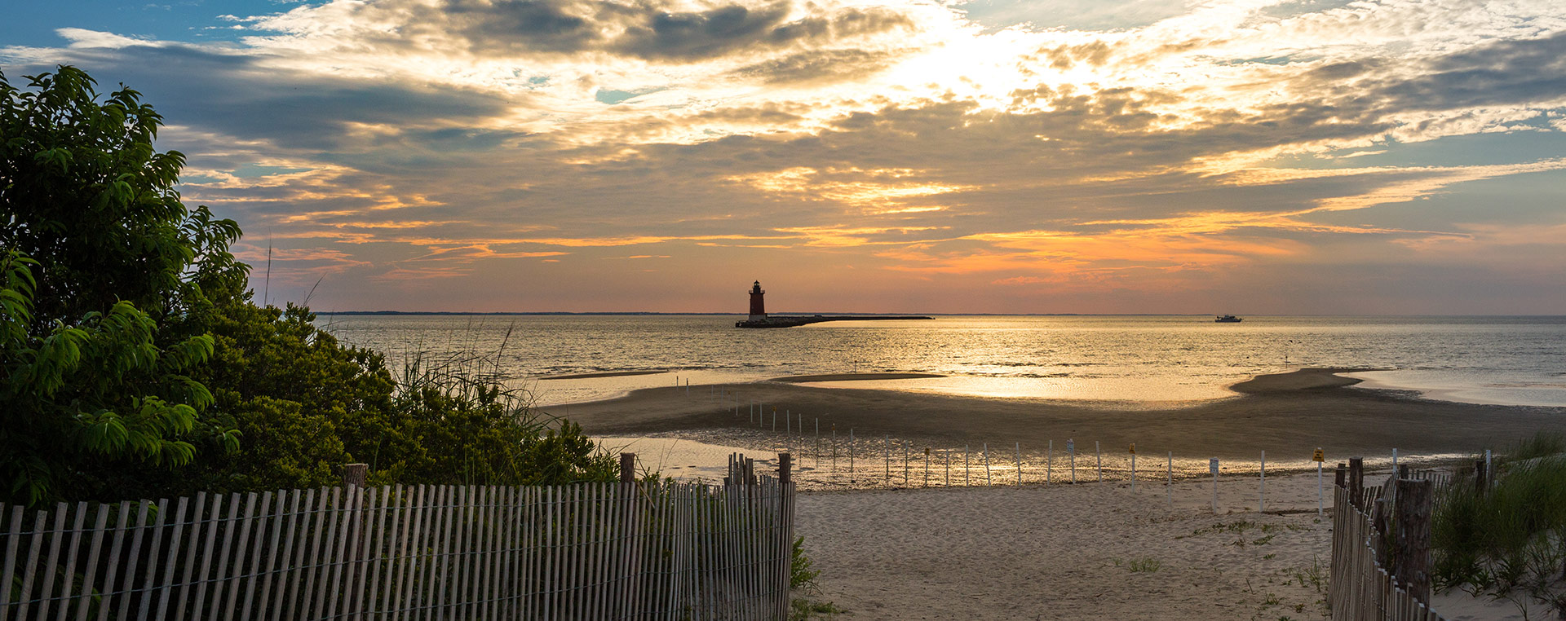
MARACOOS Overview
MARACOOS Congressional Briefing
Ocean Observing, Policy, and the Mid-Atlantic:
How Underwater Gliders Expand our Horizons
Mary Ford, Director of Engagement & External Relations
Dr. Gerhard Kuska, Executive Director
Dr. Scott Glenn, Professor, Rutgers University
Dr. Travis Miles, Professor, Rutgers University
Notes:
Intro

Slide 2
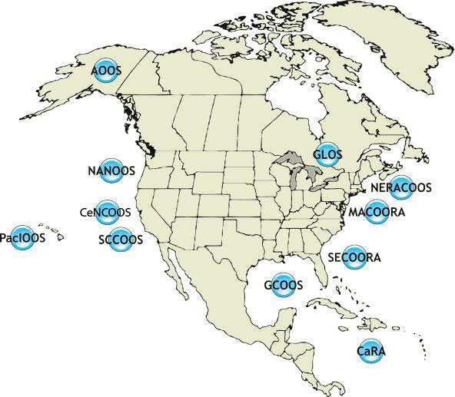
IOOS is a Public-Private Partnership
International Component
U.S. National Component
U.S. Regional Component
Vessels -
Satellite
Satellite
CODAR
Ships/ Vessels
Glider
REMUS
Data Vis.
Modeling
Security
Leadership
Education
MARACOOS
17 U.S. Federal Agencies
11 Regional Associations

Slide 3
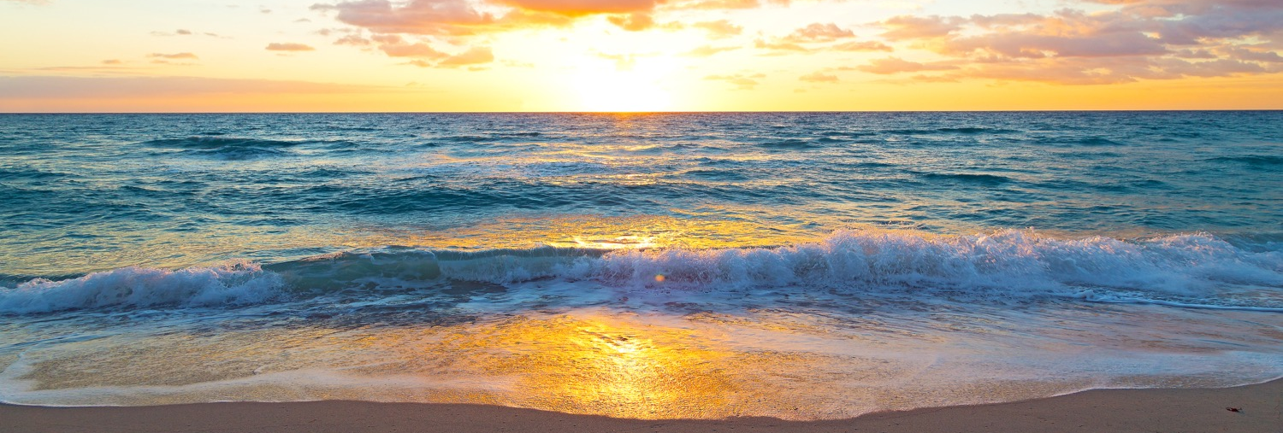
Authorizations & Appropriations from Congress
The Integrated Coastal Ocean Observing System Reauthorization
H.R. 729, the Coastal and Great Lakes Communities Enhancement Act - Rep. Kilmer (D-WA)
Passed the House
S. 914, the Coordinated Ocean Observations and Research Act – Sen. Wicker (R-MS)
Final negotiations
FY20 Appropriations
$40.5 million for IOOS Regional Observations
“The Committee supports IOOS’ efforts to expand its use of underwater gliders and encourages NOAA to fill critical gaps in the current surface mapping system to ensure streamlined access to data for weather forecasting, detection of ecological phenomena, and safe maritime operations.”
Notes:
The program is up for reauthorization right now, has passed both Senate and House at different times. Last Congress, it passed the Senate and not the House. This Congress, the House version already passed in a larger package and the Senate version has been reported out of committee but not yet passed (almost there…!).
THANK THEM for funding in the last appropriations bills note we will discuss gliders at our next webinar.
Use bolded report language to segue into HF Radar section, introduce Hugh
2 minutes maximum

Slide 4
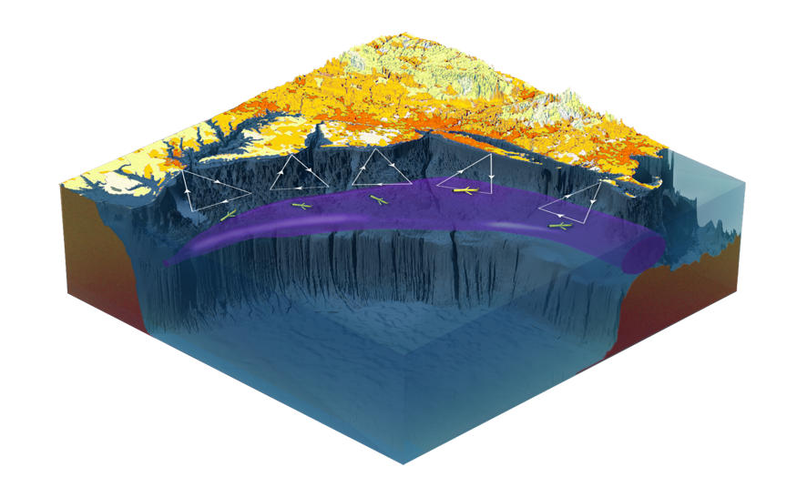
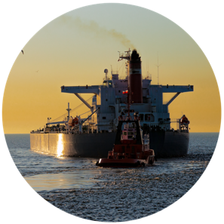
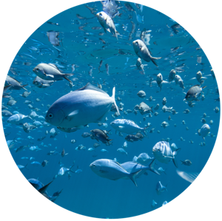
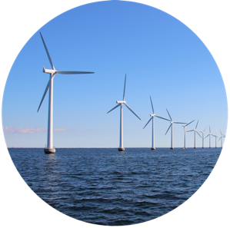
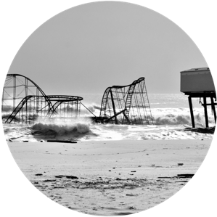
Data with Purpose
Maritime Safety
Fisheries
Energy
Water Quality
Coastal Hazards

Slide 5
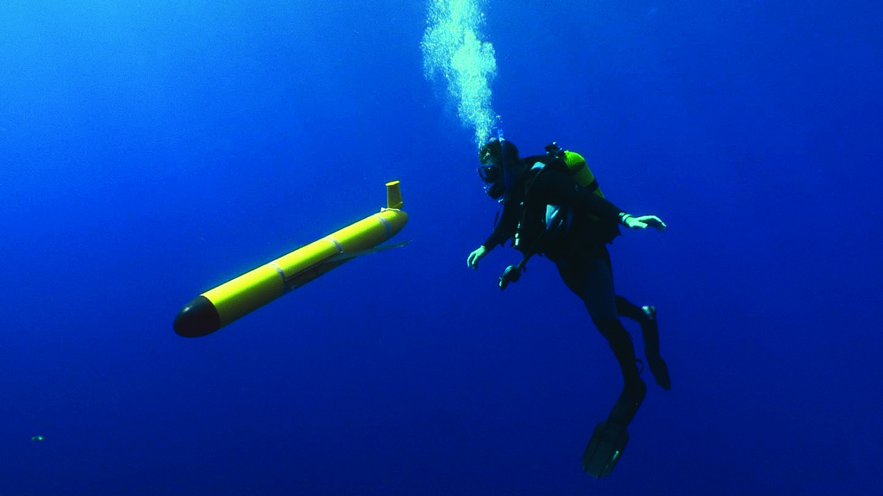

Slide 6
Underwater Gliders – A Brief History
1999 – First Glider deployed at sea
2009 – First Glider crossed the Atlantic
2019 – Key component of NOAA Unmanned Systems Strategy

Slide 7
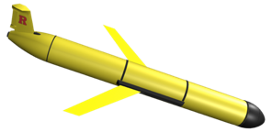
Underwater Gliders – How they Operate
Buoyancy pump propulsion
Sawtooth underwater flight pattern
Low power = long duration (1 month – 1 year)
Flexible payload bay = mission-matched sensors
Surface at regular intervals for satellite communications that:
Check GPS location
Transmit underwater data profiles to Glider Operations Centers
Download new mission commands

Slide 8
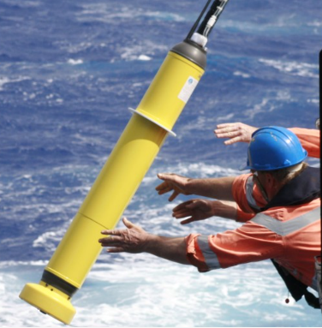
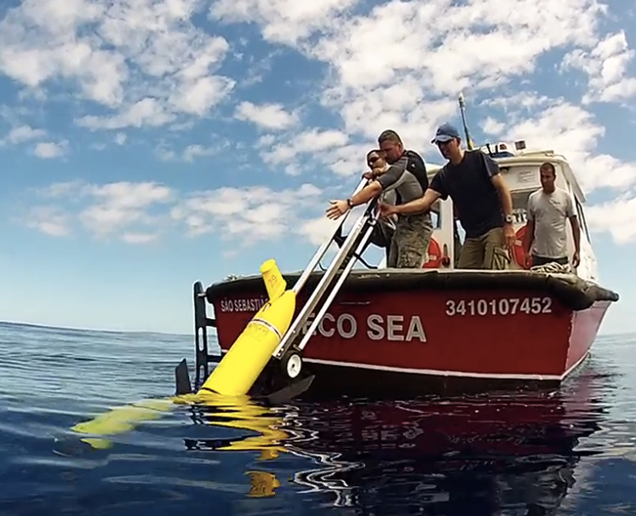
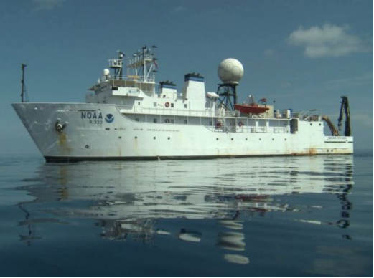
Mobile Underwater Profile Sampling Capabilities
Argo Floats
Underwater Gliders
Dedicated Ships
years
months
days
Increasing Capacity, Control, Cost, Human Involvement

Slide 9
U.S. Billion-Dollar Weather & Climate Disasters: 1980-2020
Disaster Type | Events | Percent of Total Events | Costs | Percent of Total Costs | Deaths | Percent of Total Deaths
Tropical Cyclone | 45 | 17.0% | $954.4B | 53.7% | 6,507 | 45.6%
Severe Storm | 117 | 44.2% | $253.0B | 14.2% | 1,712 | 12.0%
Drought | 27 | 10.2% | $252.7B | 14.2% | 3,865 | 27.1%
Flooding | 33 | 12.5% | $150.4B | 8.5% | 617 | 4.3%
Wildfire | 17 | 6.4% | $85.4B | 4.8% | 347 | 2.4%
Winter Storm | 17 | 6.4% | $49.6B | 2.8% | 1,048 | 7.4%
Freeze | 9 | 3.4% | $30.6B | 1.7% | 162 | 1.1%
All except Tropical Cyclone | 220 | 83.0% | $821.7B | 46.3% | 7,751 | 54.4%
All Disasters | 265 | 100.0% | $1,776.1B | 100.0% | 14,258 | 100.0%
Tropical Cyclone damages (53.7%) greater than
all other weather & climate disasters combined
https://www.ncdc.noaa.gov/billions/

Slide 10
Forecast Track and Intensity Forecast Improvements
Over the Last 30 years
200-400% improvement in track
vs.
20%-30% improvement in intensity
Evacuate vs Shelter-In-Place decisions are often made 3-5 days ahead based on the forecast intensity at landfall
The Ocean is the Energy Source for the hurricane, impacting its intensity

Slide 11
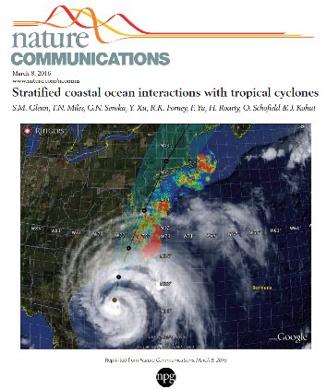
Regional Essential Ocean Features Impacting Atlantic Hurricane Intensity
Irene (2011) & Sandy (2012)
Glenn et al., 2016 Nature Comms
Seroka et al., 2016 MWR
Seroka et al., 2017 JGR Oceans
Miles et al., 2017 JGR Oceans
Xu et al., 2018 Chal Innov Oce Sen
Watkins Ph.D. Thesis
Coakley Ph.D. Thesis
Ramos-Valle Ph.D. Thesis
…
Essential Ocean Features
By Region
Seasonal Stratification, Cold Pool
Gulf Stream,
Shelf
Loop Current,
Eddies,
Fresh Water
Warm Pool,
Upper Ocean Heat Content,
Fresh Water Barrier Layers
Heat & Fresh Water
Inflow

Slide 12
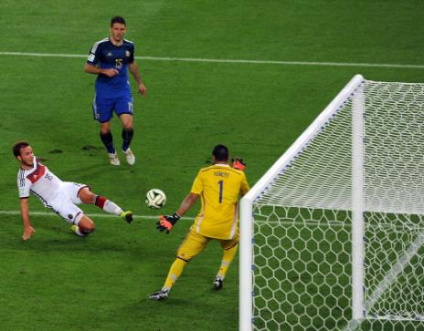
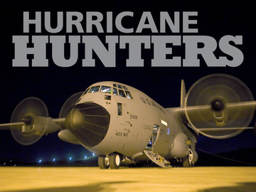
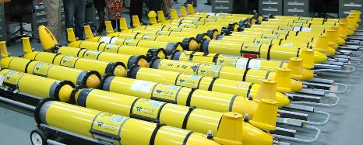
Hurricane Gliders: Key to Understanding Intensity Nationally
Soccer Analogy:
Hurricane Hunters chase the ball.
Hurricane Gliders protect the goal.
Both are required for a winning team.
HURRICANE
GLIDERS
Since
1946
Since 2014

Slide 13
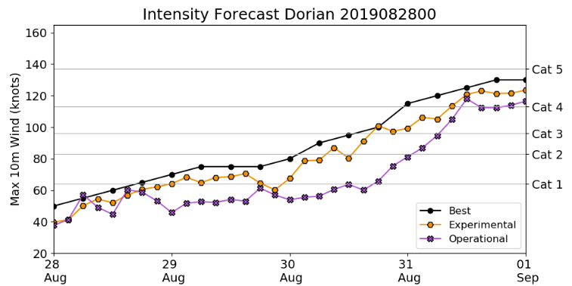
Example of Better Ocean Models Improving
Hurricane Intensity Forecasts: Hurricane Dorian
Best Analysis – Cat 3
With Ocean Data - Cat 3
Without Ocean Data - near Cat 1

Slide 14
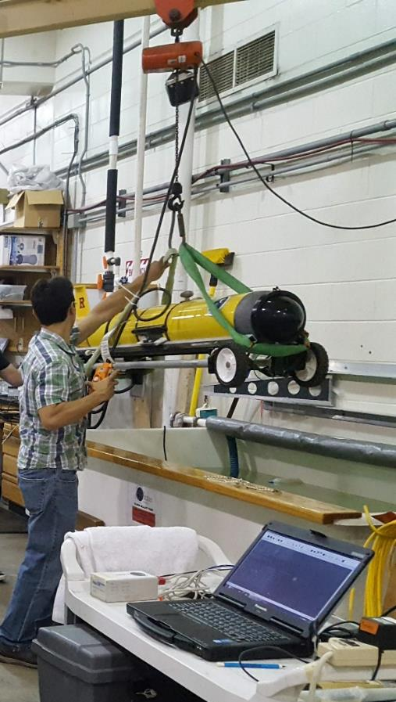
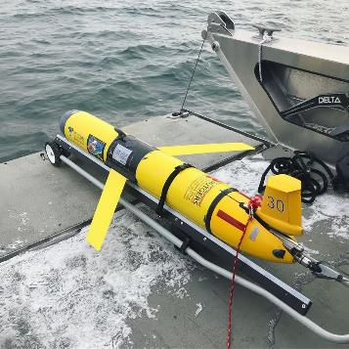
COVID-19 Response - Approved Essential Personnel & Operations

Slide 15
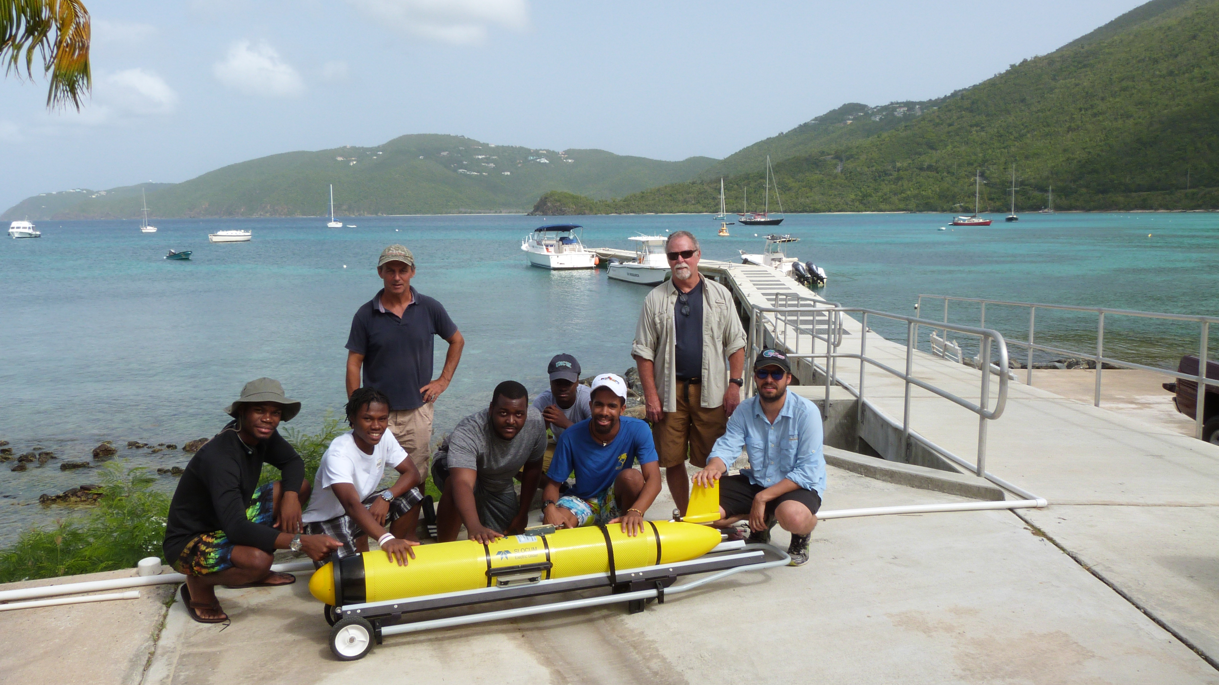
2020 Hurricane Glider COVID Challenges & Solutions
Supply chain disruptions – Spares parts and calibrated sensors stocked
Aging Infrastructure limits contingencies – Equipment refresh programs
Large ship operations curtailed – Greater reliance on regional resources
A resilient hurricane response – Maintain the distributed network!

Slide 16
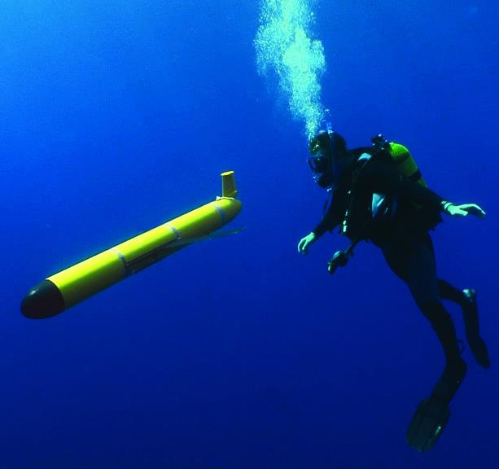
MARACOOS Underwater Gliders
Questions?
info@maracoos.org
www.maracoos.org
302-605-2727

